Slide 1
Structural Pattern
Design Pattern

Slide 2
What is Structural Pattern?
Explains how to assemble objects and classes into larger structures while keeping these structures flexible and efficient
Identifying simple way to realize relationships among entities
Serves as a blueprint for how different classes and objects are combined to form a larger structures

Slide 3
What are the Structural Pattern
Adapter
Bridge
Composite
Decorator
Facade
Flyweight
Proxy

Slide 4
Adapter Pattern
Works between two incompatible interface
Makes things work after they are designed
Provides different interface to its subject
Meant to change the interface of existing objects
Design a “wrapper” class that can “impedance match” the adaptee to the client
Identify players: the component(s) that want to be accomodated (i.e. client) and the component needs to adapt (i.e. adaptee)
Changes the interface but not the implementation

Slide 5
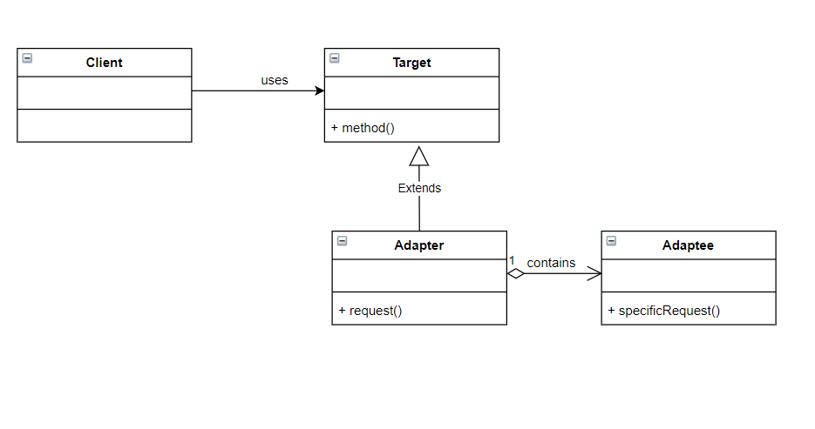
Adapter Pattern - UML

Slide 6
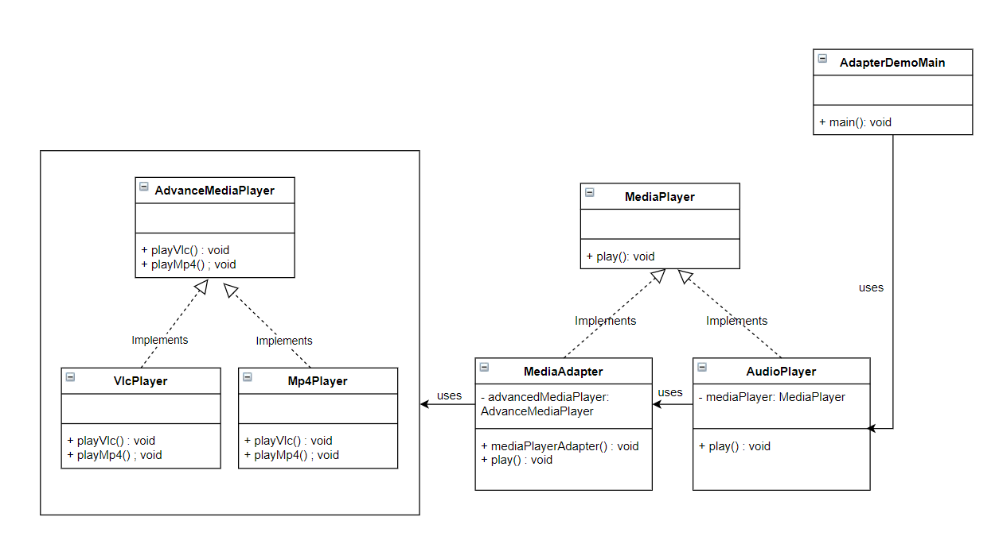
Adapter Example

Slide 7
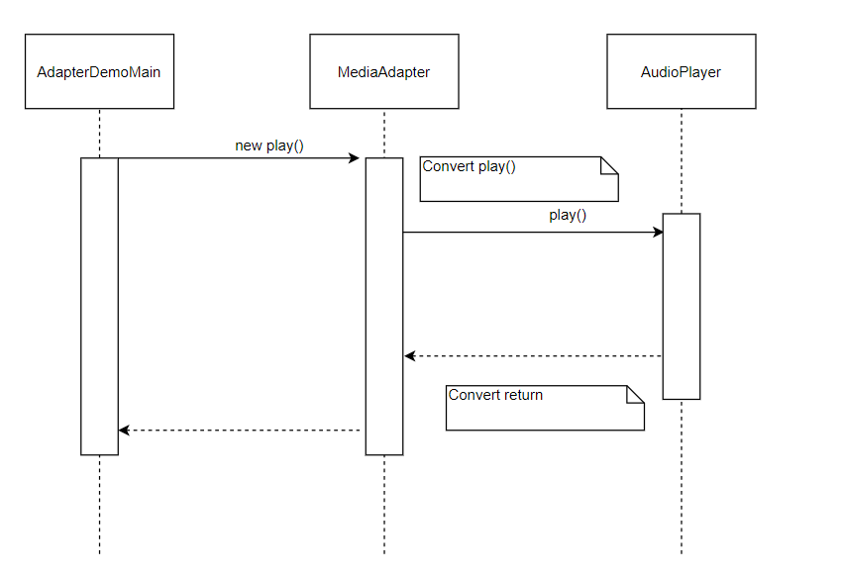
Adapter Sequence Diagram
Notes:
AdapterDemoMain invokes the MediaAdapter with generic parameters
Then the MediaAdapter converts the generic parameters for the AudioPlayer
Then the MediaAdapter invokes AudioPlayer
Then the MediaAdapter will answer as call
Then the MediaAdapter will convert the generic parameters recieve from the AudioPlayer response for the AdapterDemoMain
Finally, the MediaAdapter attends to AdapterDemoMain with generic parameters

Slide 8
Bridge Pattern
Used when we need to decouple an abstraction from its implementation so that the two can vary independently
Publish interface in an inheritance hierarchy, and bury implementation on its own inheritance hierarchy
Design up-front to let the abstraction and implementation vary independently
Makes things work before they are designed
The structure of State and Bridge are identical although the Bridge admints hierarchies of envelope classes, whereas State allows only one)
Notes:
No.1 used when we have two related pieces of software and there’s a high probability that modifying one of them can lead to have the other modified too

Slide 9
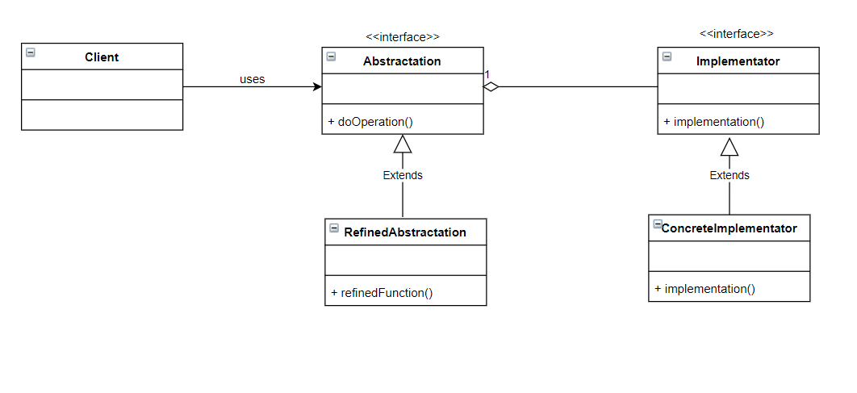
Bridge Pattern - UML

Slide 10
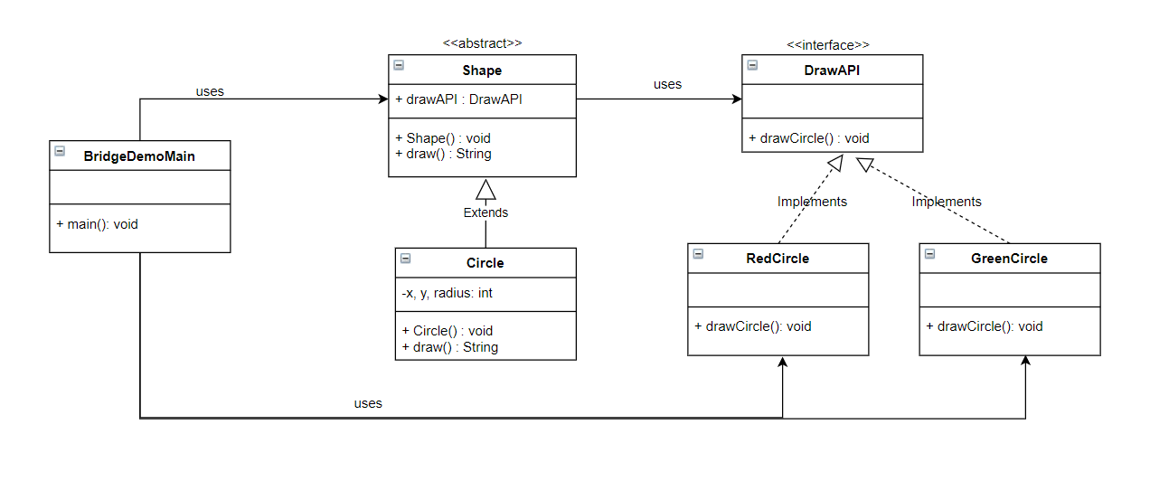
Bridge Pattern - Example

Slide 11
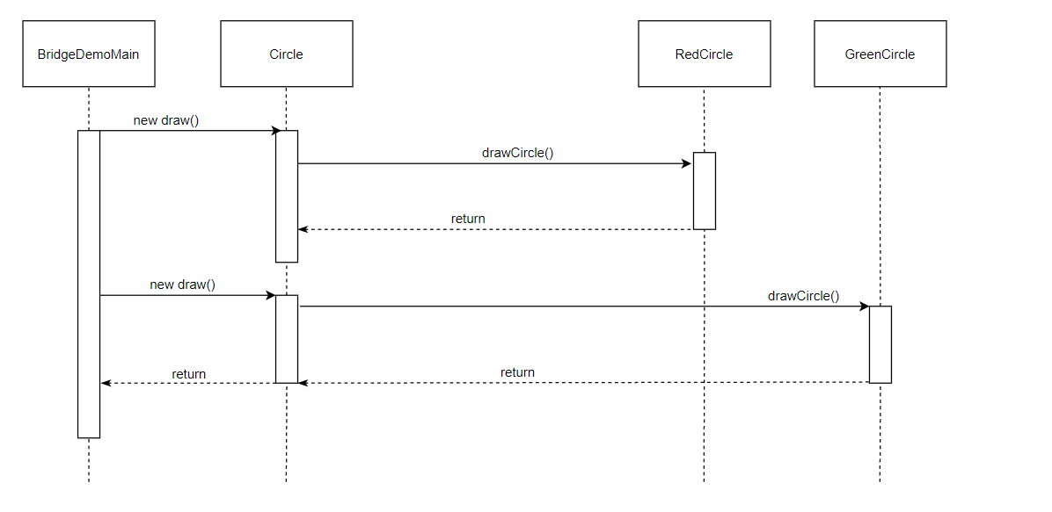
Bridge Sequence Diagram
Notes:
BridgeDemoMain will execute a new draw of Circle
Then Circle will relay this petition to RedCircle, at this time, the Circle class will convert the necessary parameters for executing RedCircle
The after RedCircle these parameters, it will do return the results from drawCircle to Circle class
Same as GreenCircle
Finally, the Circle will then converts the data that received from the RedCircle and GreenCircle, and give it to BridgeDemoMain class

Slide 12
Composite Pattern
Used when we need to treat a group of objects in similar way as single object.
Contains groups of its own objects, that provides way to modify its group of same objects
Compose objects into tree structures to represents whole-part hierarchies
Child management methods needs to [e.g. addChild( ), removeChild( )] that should be normally define in the Composite class

Slide 13
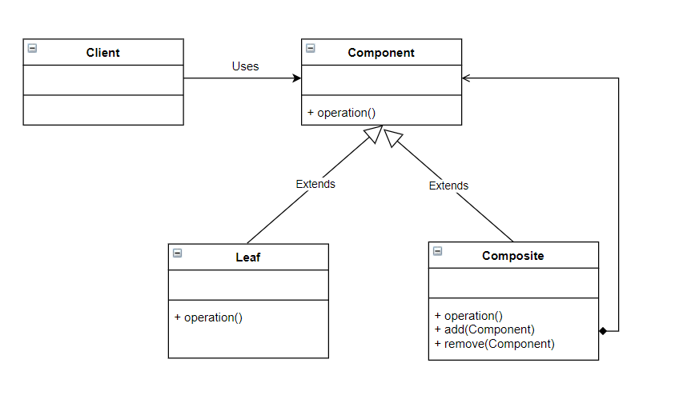
Composite Pattern - UML

Slide 14
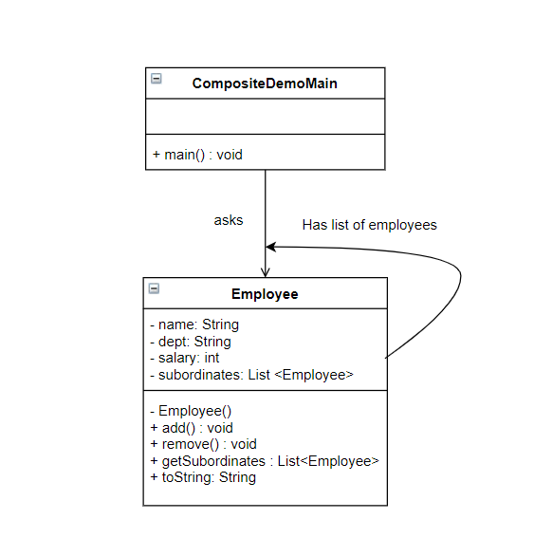
Composite Pattern - Example

Slide 15
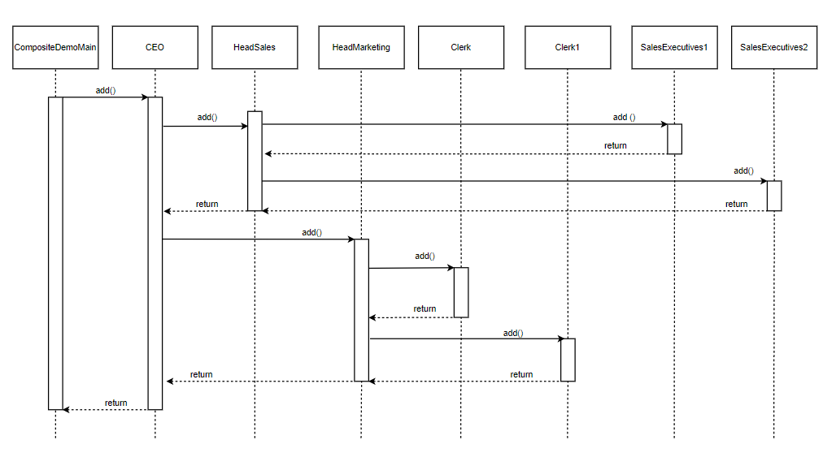
Composite Sequence Diagram
Notes:
CompositeDemoMain will add CEO
Then CEO class will add HeadSales
The HeadSales will add SalesExecutives1 and SalesExecutives 2 and return them to HeadSales class
Then the HeadSales class will then return it to CEO class
Same with HeadMarketing
Finally, The CEO will obtain the final results after evaluating the whole structure and then return it to CompositeDemoMain class

Slide 16
Decorator Pattern
Allows a user to add new functionality to an existing without altering its structure.
Wraps the original class and provides additional functionality keeping class signature intact
Provides flexible alternatives to subclassing for extending functionality
Let add responsibilities to objects without subclassing

Slide 17
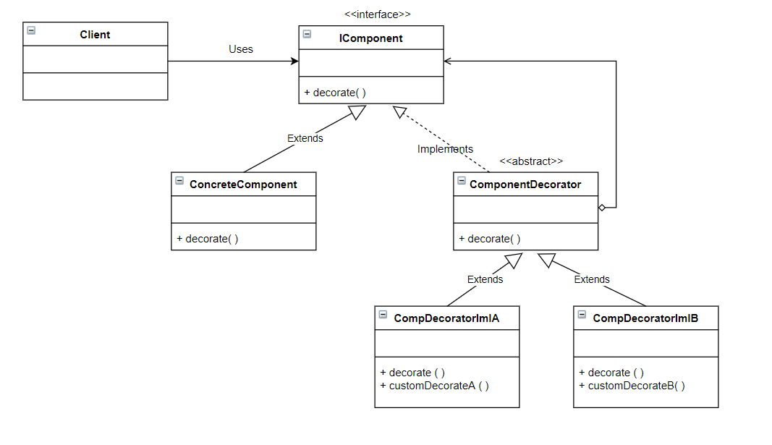
Decorator
Pattern
-
UML

Slide 18
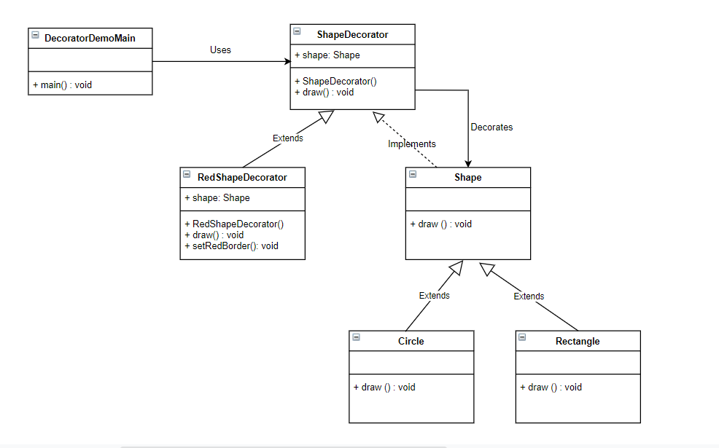
Decorator
Pattern - Example

Slide 19
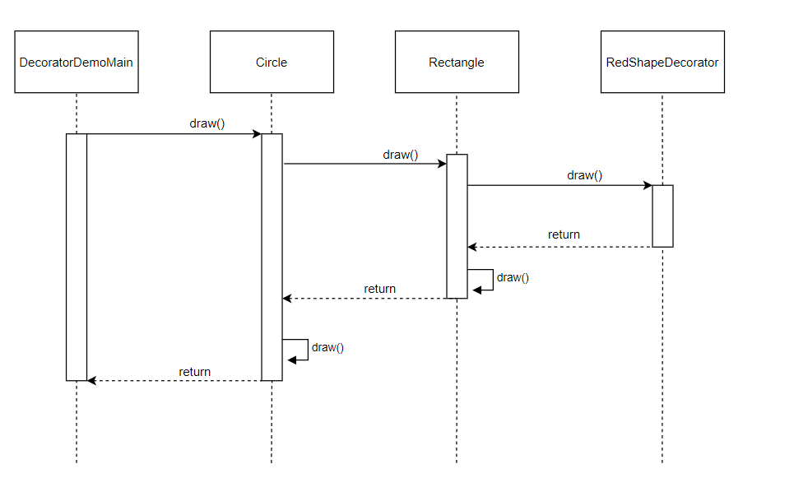
Decorator Sequence Diagram
Notes:
DecoratorDemoMain class will executes an operation on Circle class
Then Circle class will execute the same operator on Rectangle
Then the Rectangle class will execute an action over RedShapeDecorator
Then the Rectangle will execute a decorator operation
Then the Circle will execute a decorator operatotion
Finally the DecoratorDemoMain class will receive the decorated objects by all Decorators, which was encapsulated the Components with many layers

Slide 20
Facade Pattern
Hides the complexity of the system and provides an interface to the client that it can access the system.
Wrap complicated subsystems with simpler interface
Are often Singletons because only one Facade object is required

Slide 21
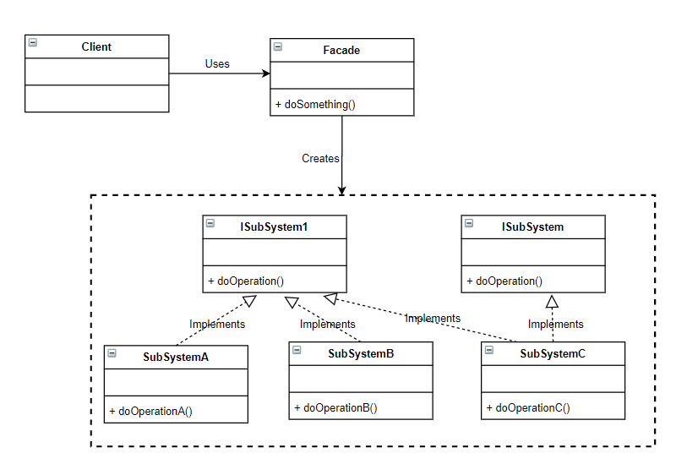
Facade
Pattern
-
UML

Slide 22
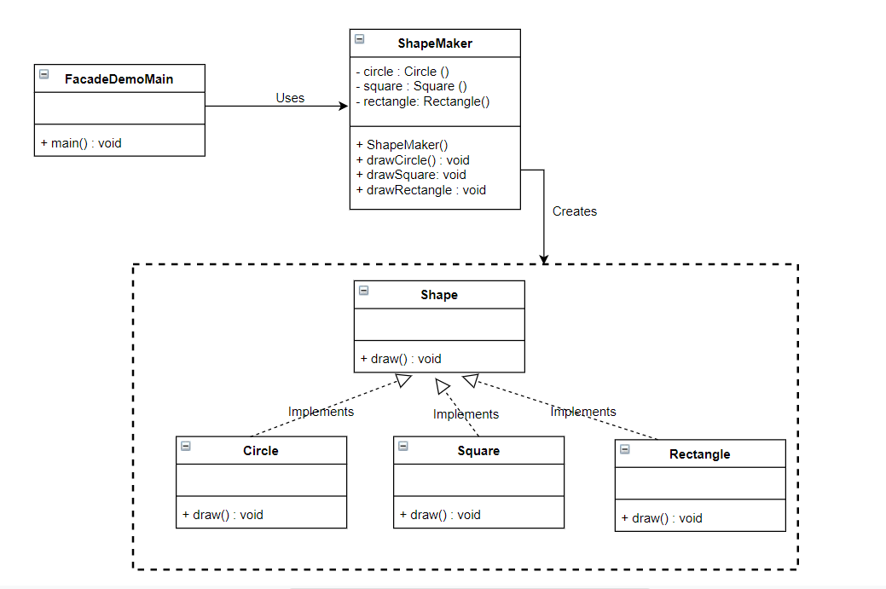
Facade
Pattern - Example

Slide 23
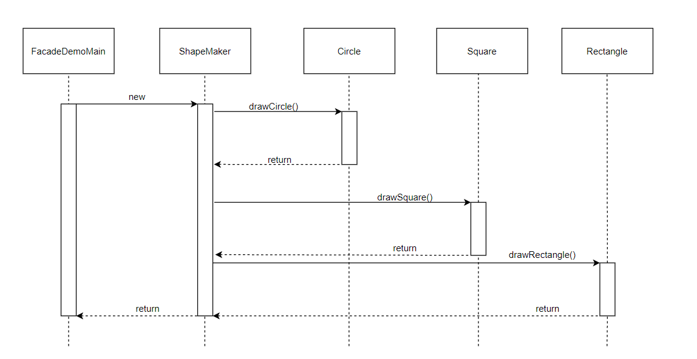
Facade Sequence Diagram
Notes:
FacadeDemoMain invokes ShapeMaker class
Then the ShapeMaker class will communicate with Circle to perform an operation and returns it
Similar ways to Square and Rectangle class
Finally, the ShapeMaker class will provide the result to FacadeDemoMaker

Slide 24
Flyweight Pattern
Is primarily used to decrease the number of objects created and decrease memory and boost performance
Reuses already existing similar kind of objects by storing them and creates a new objects when no matching will be found
Divide classes to sharable(intrinsic) state and non-shareable (extrinsic) state
Will create a Factory that can cache and can reuse existing class instances

Slide 25
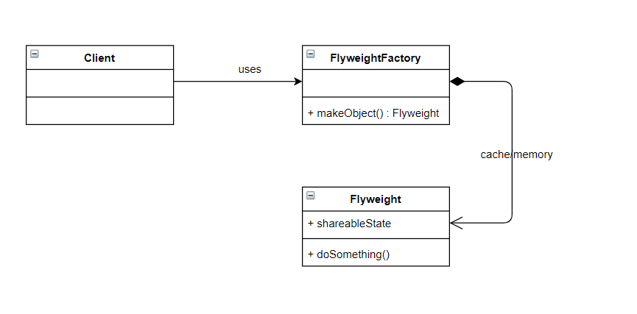
Flyweight Pattern - UML

Slide 26
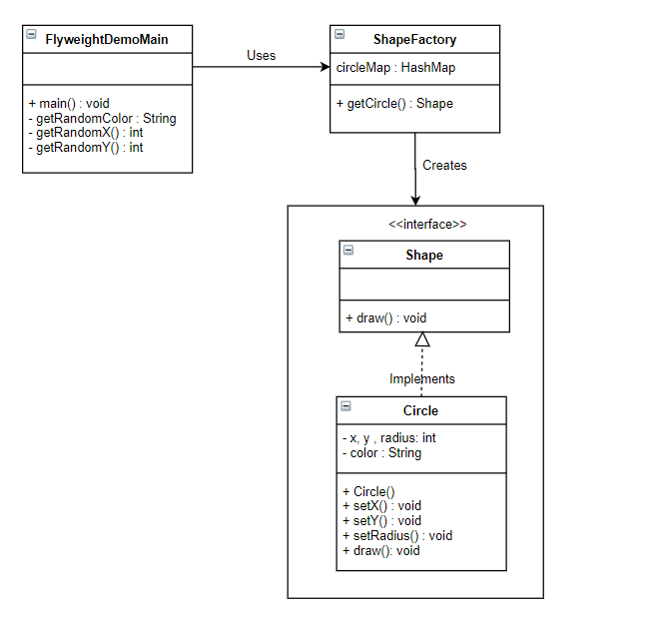
Flyweight
Pattern - Example

Slide 27
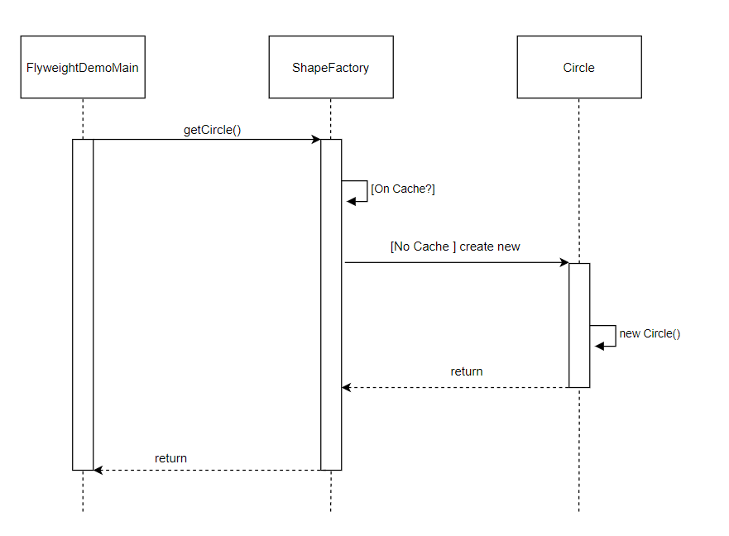
Flyweight Sequence Diagram
Notes:
FlyweightDemoMain class will request to ShapeFactory class to create Circle objects
Before the creation of objects, the ShapeFactory checks if theres an identical objects to the one being requested, if so, it will return as existing object, if not it will create new objects and store it in cache for further use
Finally, once the Circle is created or borrowed from the cache, it will return the objects to FlyweightDemoMain

Slide 28
Proxy Pattern
A class that represent other class
Provide a surrogate or a placeholder for another object to control access to it
Add a wrapper and delegation to protect the real component from undue complexity

Slide 29
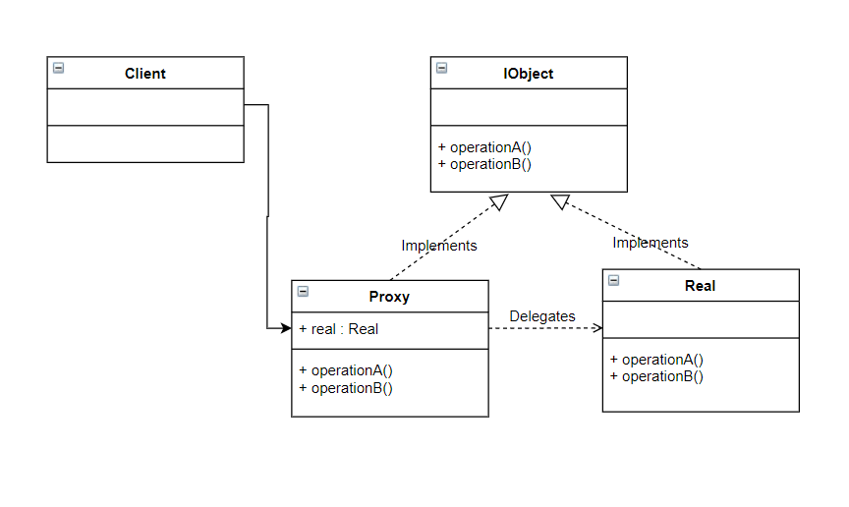
Proxy Pattern - UML

Slide 30
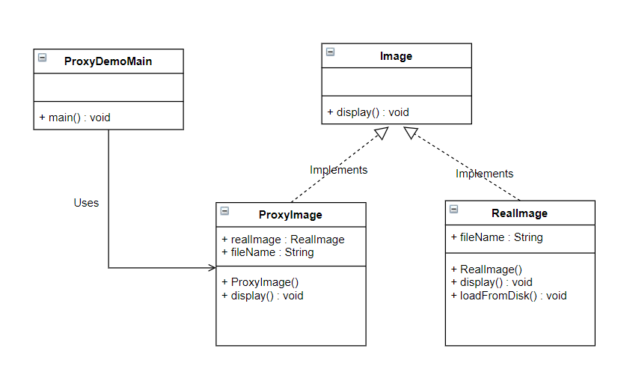
Proxy
Pattern
-
Example

Slide 31
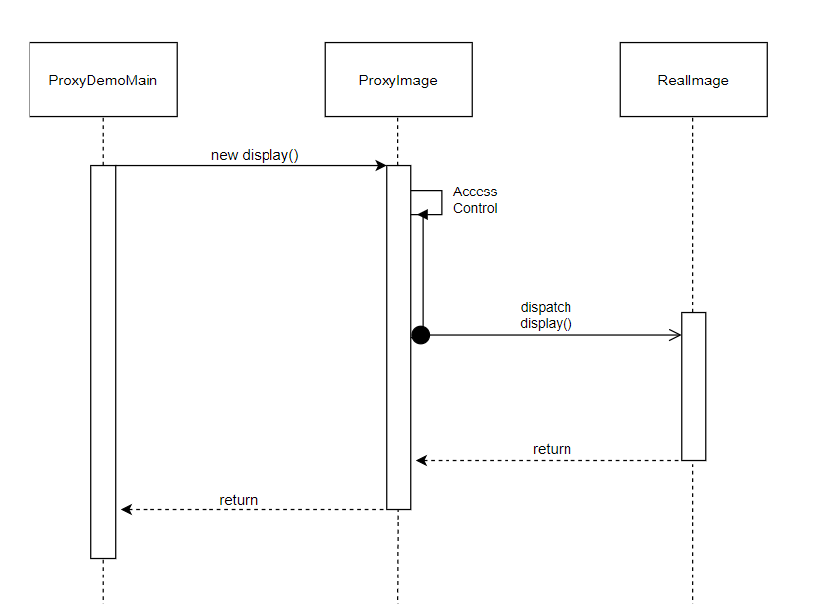
Proxy
Sequence Diagram
Notes:
ProxyDemoMain will send a request to ProxyImage to creates an object and encapsulates the RealImage
Then the ProxyImage will then perform actions before the execution of RealImage
Then the ProxyImage will hands over the execution to RealImage
Then the ProxyImage will perform actions after the execution of RealImage and return it
Finally, the ProxyImage class will return these results to ProxyDemoMain

